Slide 1
How much has Covid impacted the unemployment rate in each county in the state of NJ?
Brian Johnson

Slide 2
Data Cleaning Sources: U.S Bureau of Labor Statistics: https://www.bls.gov/ New Jersey LAWD: https://nj.gov/labor/lpa/LMI_index.html

Slide 3
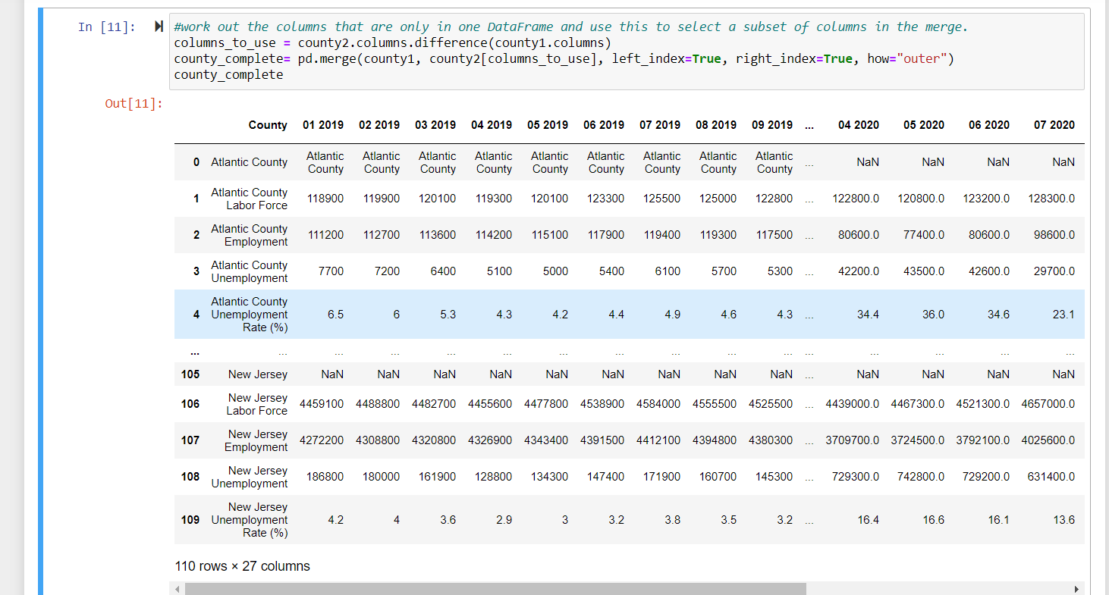
Merged 3 excel data sets (2019-2021) of different county’s employment data into a dataframe

Slide 4
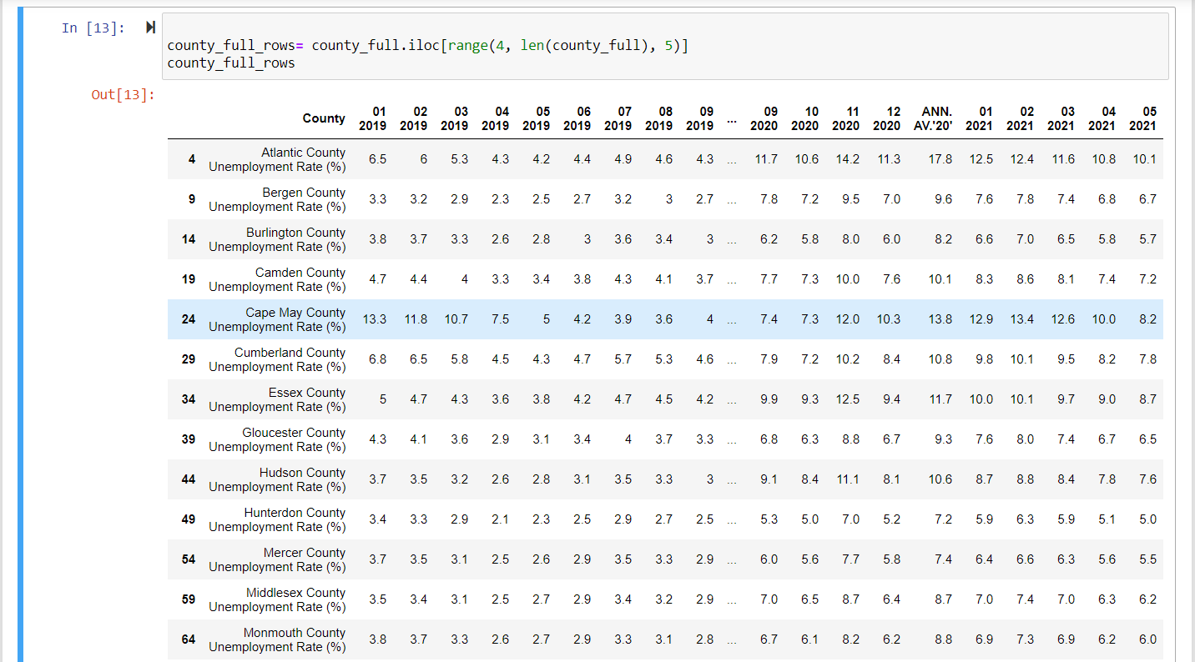
Clean Dataframe

Slide 5
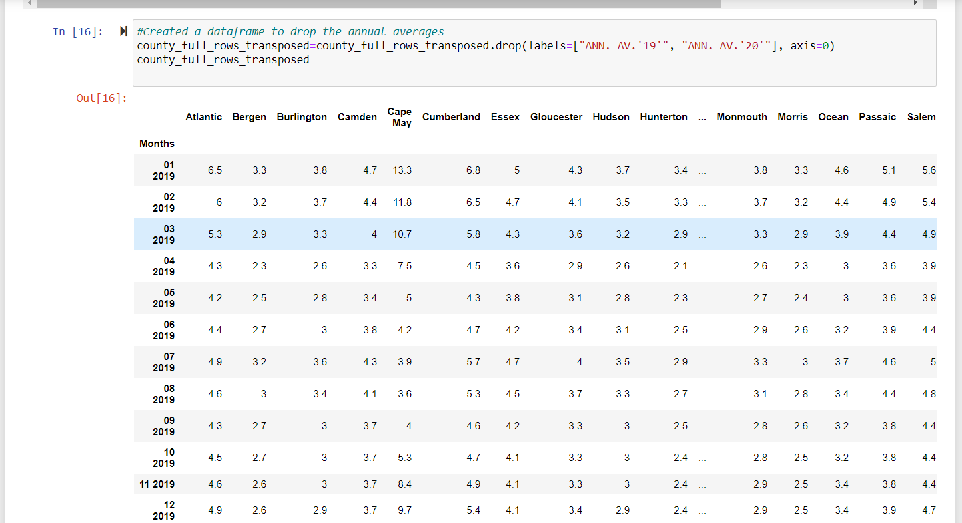
Transposed dataframe so graphs can pull from columns

Slide 6
County’s Unemployment

Slide 7
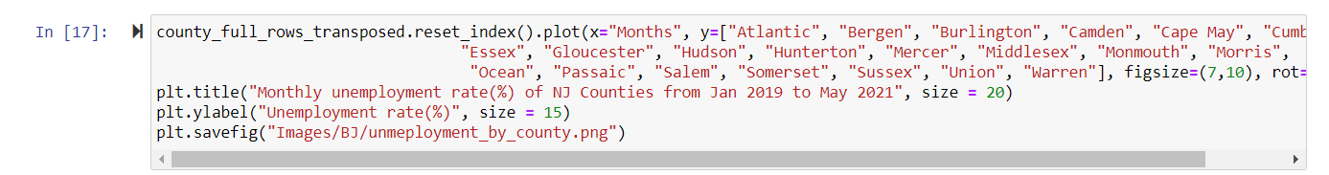
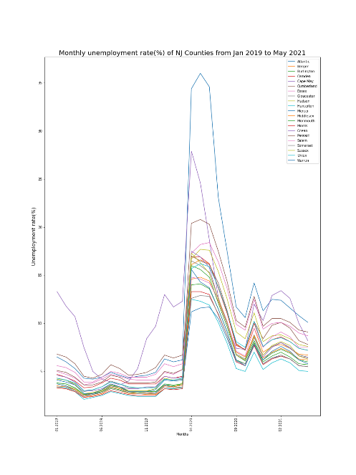

Slide 8
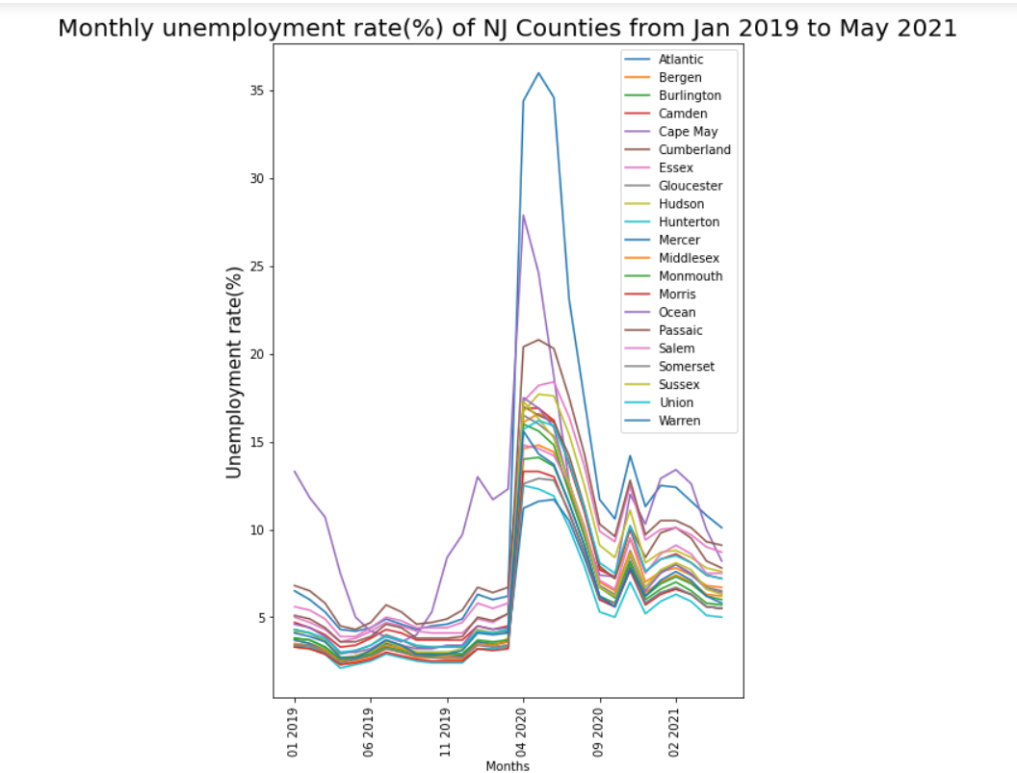
Starting around the months of April unemployment peaked till June 2020 and started to drop in July 2020.
The county with the highest unemployment rate during the peak was Atlantic County
A significant outlier before Covid was Cape May County.

Slide 9
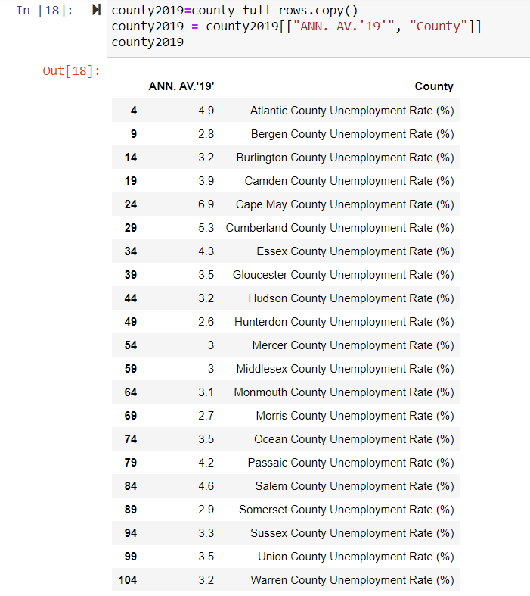
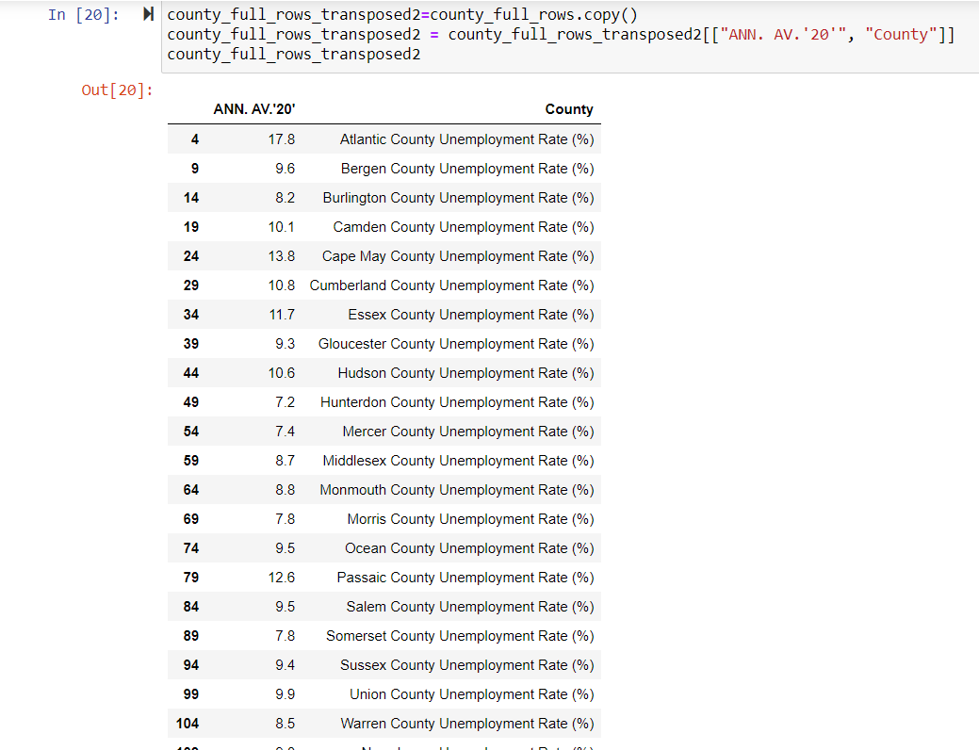

Slide 10
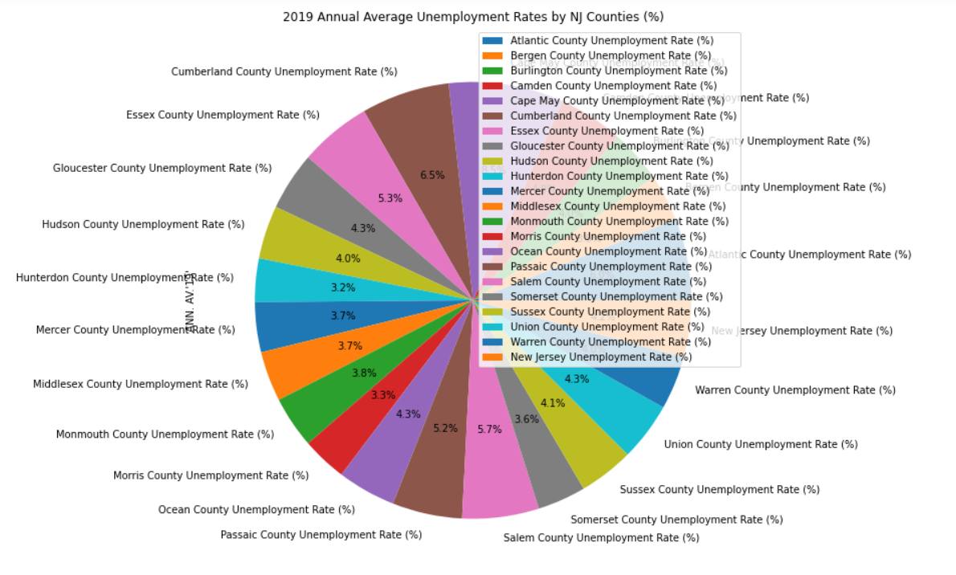

Slide 11
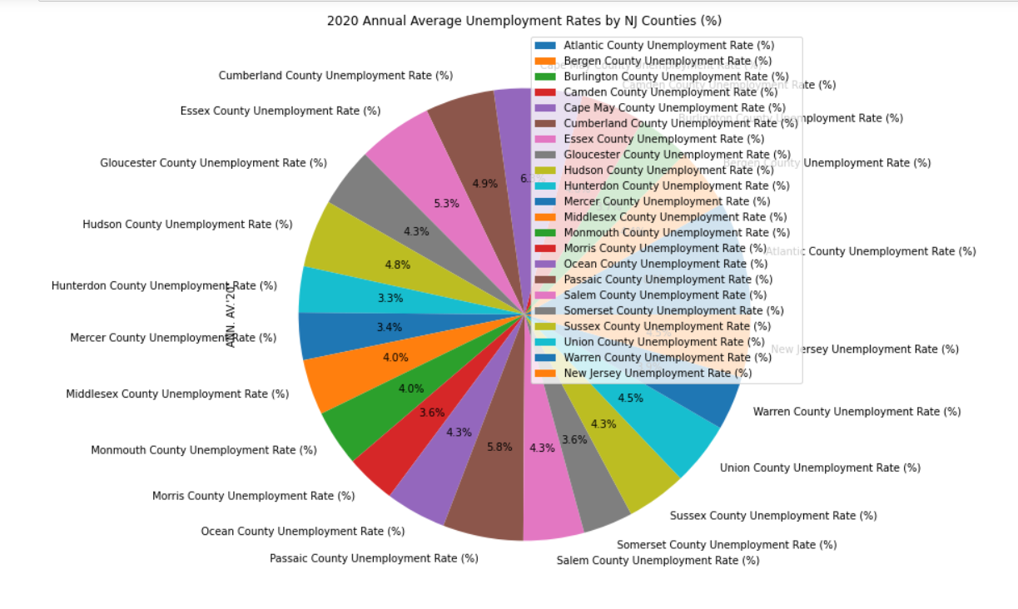

Slide 12
Pre-Covid, Cape May County had the highest unemployment rate at 6.9%.
Pre Covid, Hunterdon County had the lowest unemployment rate at 2.6%.
2020, Atlantic County became the county with the highest unemployment rate changing from 4.9% to 17.8%.
Hunterdon County remains the county with the lowest unemployment rate at 7.2% in 2020.
Cape May County ranks second highest in unemployment rates at 13.8% in 2020.

Slide 13
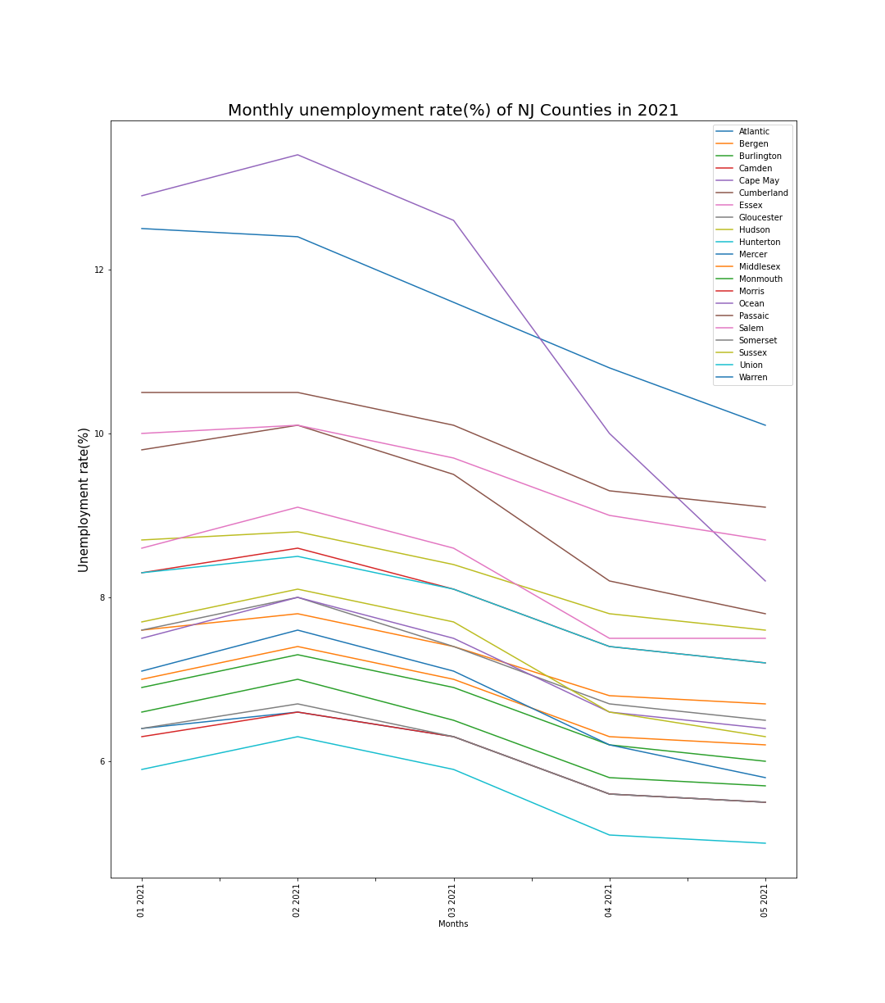
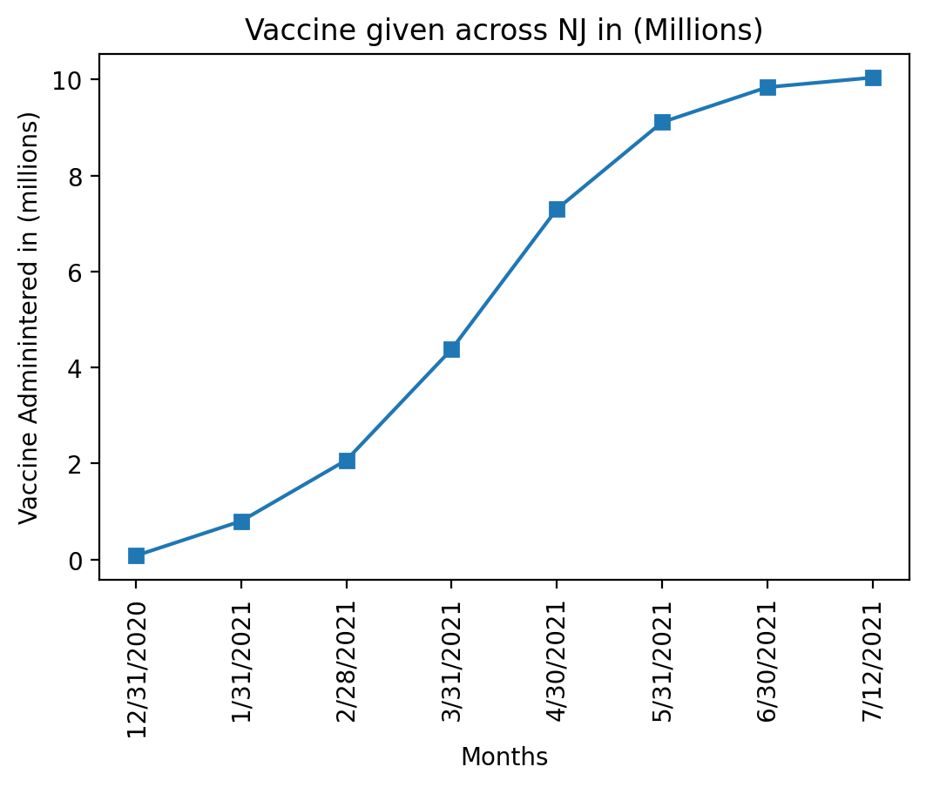
Monthly Unemployment vs. Number of Vaccines Administered

Slide 14
There is a negative correlation between number of vaccines administered and unemployment rates. As number of vaccines administered increased, the rate of unemployment throughout all counties decreased.
Vaccines administered started to plateau in June 2021 and similarly, unemployment rates also plateaued.
In conclusion, the data shows a correlation between vaccines administered and the unemployment rates in NJ. An increase in number of vaccines administered corresponded with a decrease in unemployment rates in NJ.

